Slide 1
Python’s Builtin Functions

Slide 2
The most commonly used Python builtin function: print()
“print()” function displays the value of argument passed to it.
print(5): prints 5
print(“hello world”): prints the message “hello world”
Some other built-ins that come in handy are: input(), len(), type() etc.
first_name = input(“Enter your first name: ”)
len(“Rakesh”) --> 6

Slide 3
len()
It tells you the number of characters in the string.
>>> len("rakesh")
6
>>> len("vikash")
6
It is also able to tell you the number of elements in a list / sequence.
>>> len([1, 2, 3, 5, 7])
5
>>> len(['rakesh', 'vikash', 'ashish'])
3

Slide 4
Some Numbers Related Builtin Functions
abs() Returns the absolute value of a number
bin() Returns the binary version of a number
complex() Returns a complex number
divmod() Returns the quotient and the remainder when argument1 is divided by argument2
max() Returns the largest item in an iterable
min() Returns the smallest item in an iterable
pow() Returns the value of x to the power of y
range() Returns a sequence of numbers, starting from 0 and increments by 1 (by default)
round() Rounds a number
sum() Sums the items of an iterator

Slide 5
>>> l = [5, 6, 2, 0, 9]
>>> max(l)
9
>>> min(l)
0
>>> sum(l)
22
>>> round(5.2)
5
>>> round(5.9)
6
>>> round(5)
5

Slide 6
range()
Range takes three arguments: start, stop, step
But start and step are optional. What does that mean?
They can some default values, like:
Start: 0
Step: 1
Note: Range is exclusive of ‘stop’
>>> list(range(1, 11))
[1, 2, 3, 4, 5, 6, 7, 8, 9, 10]
>>>
>>>
>>> list(range(2, 20, 2))
[2, 4, 6, 8, 10, 12, 14, 16, 18]
>>>
>>> list(range(10))
[0, 1, 2, 3, 4, 5, 6, 7, 8, 9]
>>>
>>>
>>> list(range(0, 10))
[0, 1, 2, 3, 4, 5, 6, 7, 8, 9]
>>>
>>> list(range(0, 10, 2))
[0, 2, 4, 6, 8]
>>>
>>> list(range(0, 10, 3))
[0, 3, 6, 9]
>>>

Slide 7
pow()
>>> pow(2, 5)
32
>>> 2 ** 5
32
Python is very flexible. In most situations, it gives you more than one way to do things.

Slide 8


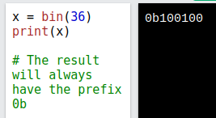
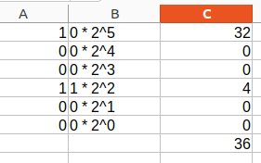




Some Examples
First: quotient
Second: remainder
Return the value of 4 to the power of 3 (same as 4 * 4 * 4):

Slide 9
ord() and chr()
Here, ord() and chr() are built-ins.
Ord(): gives you ASCII for the alphabet
Chr(): gives you the alphabet for the ASCII
>>> ord('A')
65
>>> chr(65)
'A'

Slide 10
Some Type Casting Related Builtin Functions
bool() Returns the boolean value of the specified object
dict() Returns a dictionary (key-value pairs)
float() Returns a floating point number
int() Returns an integer number
list() Returns a list
set() Returns a new set object
str() Returns a string object
tuple() Returns a tuple (tuple is an immutable list)
type() Returns the type of an object

Slide 11
Type Casting Built-ins: bool()
>>> 0
0
>>> True
True
>>> bool(0)
False
>>> bool(-1)
True
>>> bool(1)
True
>>>
>>> bool('A')
True
>>>
Extra Information:
Q1: Trick question about a set.
>>> {True, False, True}
{False, True}
>>> {True, False, 0, 1}
{False, True}
Q2: Trick question about if-else:
var = 0
if(True):
print("Got True")
if(var):
print("In If")
else:
print("In Else")

Slide 12
Type Casting Built-ins: bool()
if(True):
print("Got True")
This is equivalent to directly saying:
print(“Got True”)
if(False):
print(“Got False”)
This is equivalent to not writing any code.
if(False) --> The conditional expression always to evaluates to False
Problem:
if(True):
print("in if")
else:
print("in else")
if(False):
print("in if")
else:
print("in else")

Slide 13
int() and list()
>>> int("5")
5
>>> int("5XYZ")
Traceback (most recent call last):
File "<stdin>", line 1, in <module>
ValueError: invalid literal for int() with base 10: '5XYZ'
>>> age = input("Enter your age: ")
Enter your age: 20
>>> type(age)
<class 'str'>
>>> salary = int(input("Enter your salary: "))
Enter your salary: 5000
>>> type(salary)
<class 'int'>
>>> age
'20'
>>> salary
5000
>>> float('5.2')
5.2
>>> float('5.2XYZABC')
Traceback (most recent call last):
File "<stdin>", line 1, in <module>
ValueError: could not convert string to float: '5.2XYZABC'
>>> float(5)
5.0

Slide 14
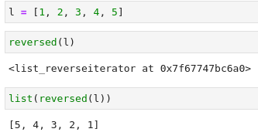
Some Examples of Type Casting Related Builtin Functions
We saw this in code for building a calculator:
num1 = float(input("Enter the 1st num:"))
Use of list() when you want to reverse a list:

Slide 15
Finding volume of a cube
# Variable declaration. s is holding the side length.
s = input("Enter the side: ") # input() gives you a string
print(type(s))
s = float(s) # Type casting builtin for getting the float value of r
volume=pow (s,3) # Computation
print(volume)

Slide 16
Some Builtins For Processing a List
enumerate() Takes a collection (e.g. a tuple) and returns it as an enumerate object
filter() Use a filter function to exclude items in an iterable object
iter() Returns an iterator object
map() Returns the specified iterator with the specified function applied to each item
range() Returns a sequence of numbers, starting from 0 and increments by 1 (by default)
reversed() Returns a reversed iterator
sorted() Returns a sorted list
slice() Returns a slice object
zip() Returns an iterator, from two or more iterators

Slide 17
Some Examples of Builtins For Processing a List (Part 1)
>>> l = [5, 1, 9, 2, 4, 7] # Here, your list is a sequence of integers.
>>> max(l)
9
>>> min(l)
1
>>> sum(l)
28
>>> sorted(l)
[1, 2, 4, 5, 7, 9]
>>> sorted(l, reverse=True)
[9, 7, 5, 4, 2, 1]
>>> l
[5, 1, 9, 2, 4, 7]
>>>
>>> list(reversed(l))
[7, 4, 2, 9, 1, 5]
>>>
>>> list(range(10))
[0, 1, 2, 3, 4, 5, 6, 7, 8, 9]
>>>
>>> list(range(0,10,1))
[0, 1, 2, 3, 4, 5, 6, 7, 8, 9]
>>> list(range(0,10,2))
[0, 2, 4, 6, 8]
>>> l = ["alpha", "beta", "gamma", "delta", "epsilon"] # sequence of strings
>>> max(l)
'gamma'
>>>
>>> ord('a')
97
>>> ord('b')
98
>>> ord('g')
103
>>> min(l)
'alpha'
>>>
>>> sorted(l)
['alpha', 'beta', 'delta', 'epsilon', 'gamma']
>>> list(reversed(l))
['epsilon', 'delta', 'gamma', 'beta', 'alpha']
>>>

Slide 18

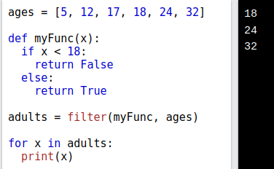
Some Examples of Builtins For Processing a List (Part 2)

Slide 19

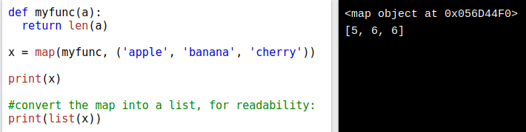
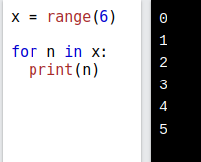

Slide 20
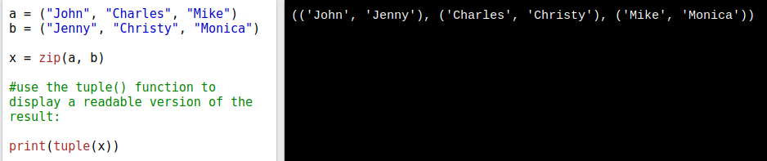

Slide 21
Practice Problems
1. Create a dictionary using Python built-ins that would have alphabets as keys and ASCII code as values.
2. Create a dictionary using Python built-ins that would have ASCII code as the key, and alphabets as values.

Slide 22
Ref: https://www.w3schools.com/python/python_ref_functions.asp

